Slide 1
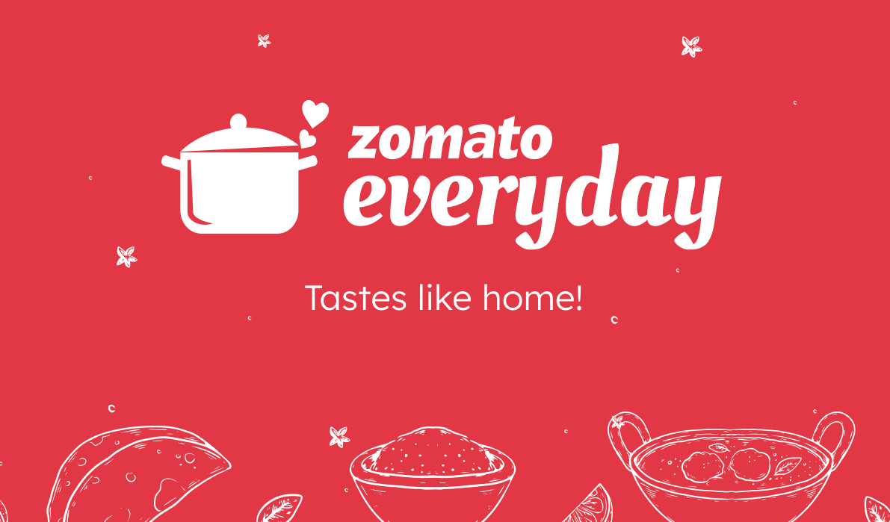

Group No. 4
Devashish Sonawane

Slide 2
Introduction
Founding (2008): Zomato was founded in July 2008 by Deepinder Goyal and Pankaj Chaddah in New Delhi, India, under the name "Foodiebay." It started as an online restaurant discovery platform. Zomato is an Indian food delivery startup restaurant aggregator. It primarily provides concrete information, menus, and user reviews of the restaurants. Along with this, Zomato also has food delivery options from partnered restaurants in the selected cities. All of it started when the founders, Deepinder Goyal and Pankaj Chaddah were in their office in New Delhi and they came across so many people who were waiting for a long time just to acquire a flash of the menu card. And in that exact moment, the idea for obtaining a solution was planted in this duo’s minds and that led them to launch Zomato, formerly known as ‘Foodiebay’.
Expansion (2010): The company expanded rapidly, and in 2010, it rebranded to "Zomato." It began to offer more features and started operations in multiple cities across India.
Global Expansion (2012-2015): Zomato's success in India led to international expansion. It entered the global market by acquiring restaurant discovery platforms in various countries, including the UK, UAE, New Zealand, and more.
Diverse Services (2014): Zomato expanded beyond restaurant discovery, adding online ordering and table reservations. This move broadened its services and customer base.

Slide 3
Tools
Tools I have used to analyze the Data -
The project showcases the use of Excel, SQL, and dashboard tools such as Power BI and Tableau for data analysis and visualization, and provides a valuable resource for anyone interested in learning more about these tools and techniques.
Excel To achieve the objectives of the Zomato Restaurant Data Analysis project, various advanced Excel functions were used, including:
SUMIFS and COUNTIFS functions to extract and count data based on specific criteria PivotTables and PivotCharts to summarize and analyze data Conditional formatting to highlight key insights in the data Report connections to link multiple PivotTables and charts to a single slicer, allowing for dynamic filtering of the data VLOOKUP and INDEX-MATCH functions to merge data from different tables DATE and YEAR functions to extract information from date fields

Slide 4
Data Challenges & Cleaning
File Size Limit Exceeded: It showed some error while importing the Zomato dataset.
Rating: The rating was not in proper numerical format, i.e. some ratings had decimal values.
Blank rows: It has some blank rows in the cuisines column so I removed them to match all the rows.
Date Format: The date was not in format, to make it I changed “_” to “-” and made it in “yyyy-mm-dd” format.
All the data was not getting imported into the MySQL server for which we deleted unused columns.
For restaurants with names like “Café” the “é” is observed to be replaced with special characters like “ƒ”,” Â”,”©”. I performed multiple replace operations on the column “name” to handle the same.
Duplicates were checked for the entire dataset and if any were removed.

Slide 5
Insights 1 Report
As we can see India has more restaurants in all the countries.
In the 2nd chart we see that 2011 & 2018 has more restaurants outlets in the world.
There is a summary table that displays useful details such as restaurant name, Location, average rating, Avg Cost for 2, Book Table, Online Order average cost

Slide 6
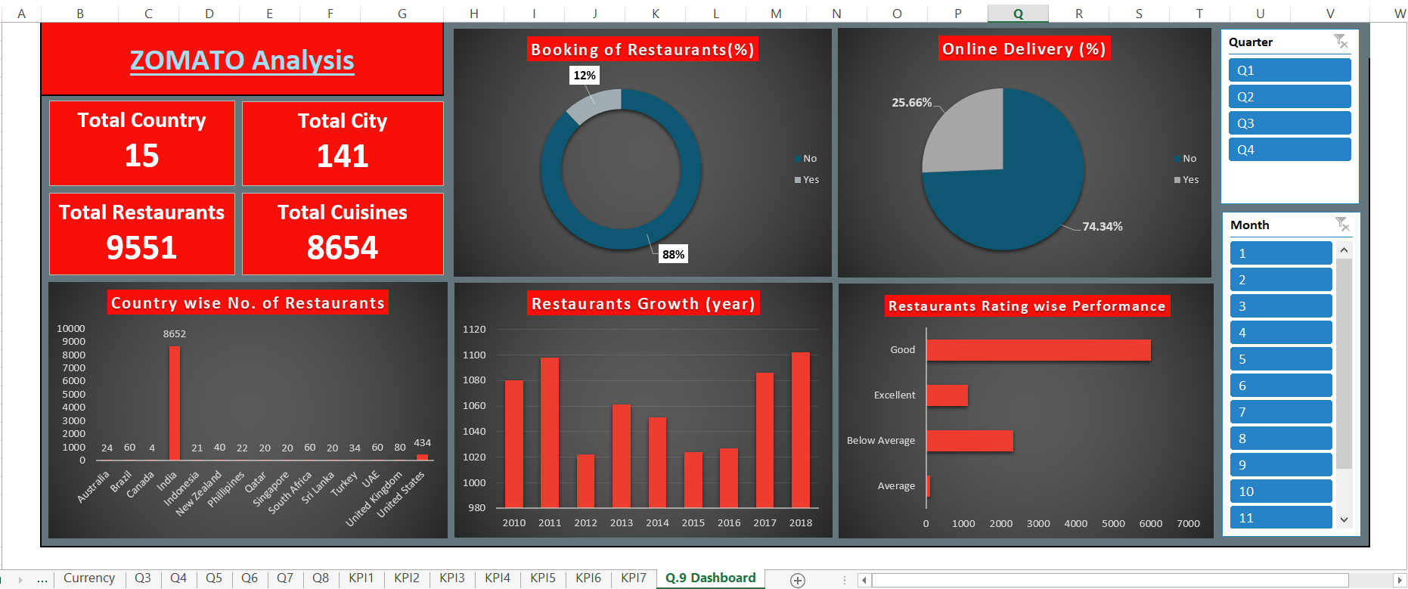
Dashboard (Excel)

Slide 7
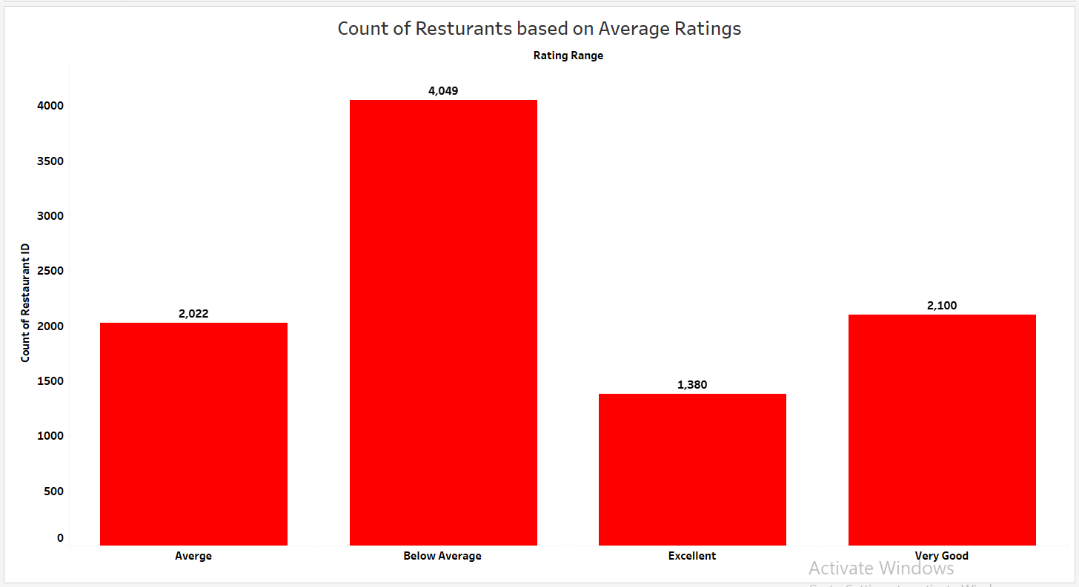
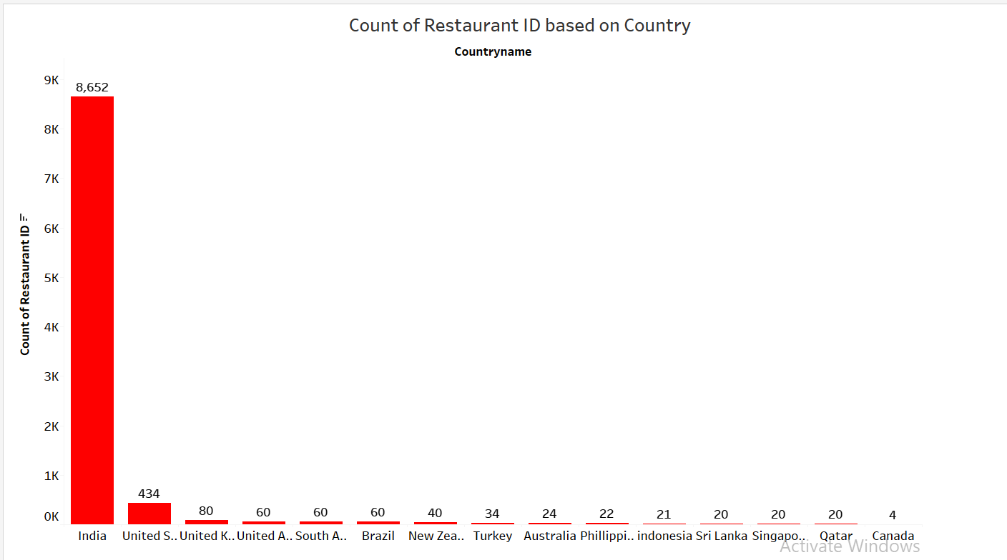
Insights from 2nd Report
Most of the restaurants serve and deliver food for under Rs 1000 for 2 People and a good number of restaurants serve a wide variety of dishes in the price range of INR 250 to INR 500.
Most of the restaurants fall under the ratings.
Most Restaurants can maintain higher ratings even without offering Table Bookings.

Slide 8
Conclusion
The most available cuisine is North Indian followed by Chinese, Fast-food, and South Indian.
A huge percentage of restaurants offer online orders but very few offer table bookings.
The maximum no of restaurants (44.65 %) falls under the Meal Type Delivery
The number of restaurants is dense towards central Bangalore. You can use the map visualization provided to zoom in and zoom out to get a much clearer idea about the location and number of restaurants available at that particular location. and 38.06% restaurants fall under Dine-Out.
Most Restaurants can maintain higher ratings even without offering Table Bookings.
Maximum no of restaurants (44.65 %) falls under the Meal Type Delivery and 38.06% restaurants fall under Dine-Out.

Slide 9
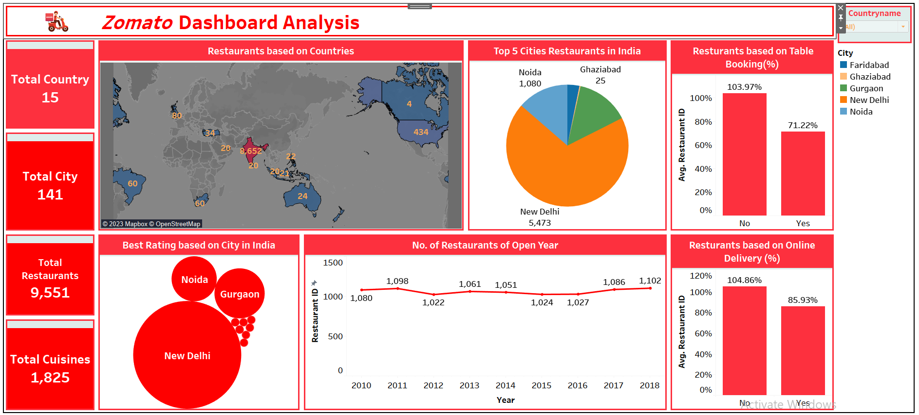
Dashboard (Tableau)

Slide 10
Q & A
Consider tailoring your restaurant's menu to cater to regional preferences. If you notice a strong preference for North Indian cuisines in your area, including diverse North Indian dishes could attract more customers.
After analyzing the pricing of the dishes in comparison to popular North Indian cuisines. The pricing aligns with customer expectations and the market.
While North Indian cuisine is popular, consider diversifying your menu to attract a broader range of customers. Offering choices for various tastes can increase customer appeal.
Develop marketing campaigns that highlight your restaurant's strengths, such as unique North Indian dishes or exceptional service.
Continue to gather and analyze data to inform the business decisions. Regularly review customer preferences and adapt your offerings accordingly.

Slide 11


